Slide 1
Intro to Machine Learning: Random Forests
Presenters: Elda Piedade and Thang Nguyen (Ethan)
Topic Outlines:
What is Data Science?
Definition
DS application in real world
How do models work?
Core concept
Supervised learning
Accomplishment
Data Cleaning
Enhance Decision Tree and Random Forests.

Slide 2
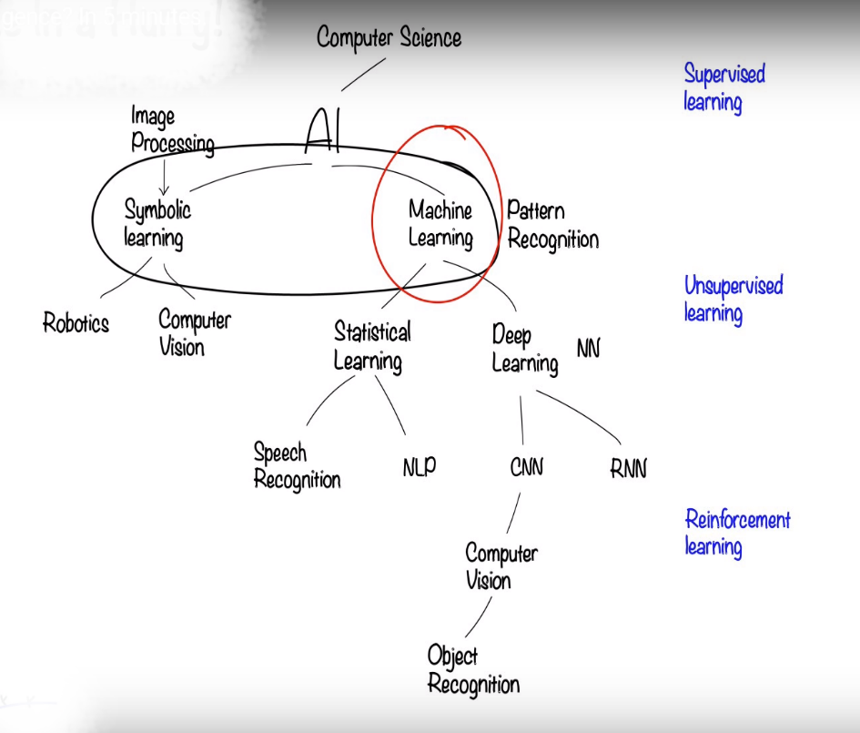
What is Data Science?
Data Science is the study of how to extract meaning from and interpret data, which requires both tools and methods from statistics and machine learning.
Random Forests’ Application:
Regression and Classification Problems.
Examples: predicting patients’ survival, predicting house’s prices, etc.
*Note:
NN: Neural Network
NLP: Natural Language Processing
CNN: Convolutional Neural Network
RNN: Recurrent Neural Network

Slide 3

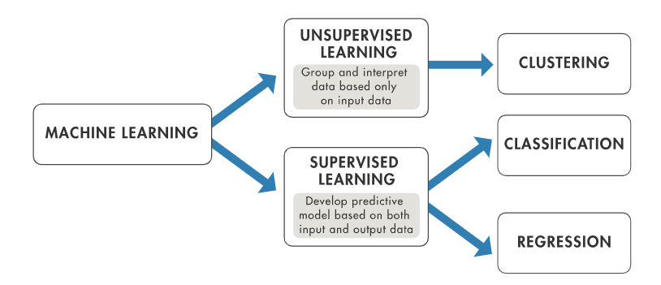
How do Models Work?
Model in Machine Learning (ML) consists of two types:
Unsupervised Learning
Supervised Learning

Slide 4
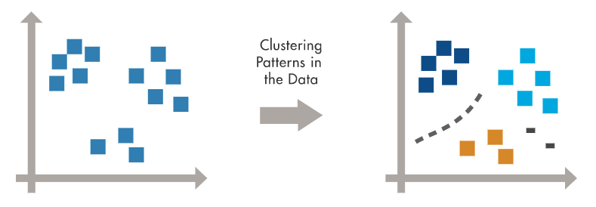
How do Models Work?
Unsupervised Learning: finds hidden patterns or intrinsic structures in data of which input data do not contain labeled responses.
Clustering is the most common unsupervised learning technique. Applications for cluster analysis include gene sequence analysis, market research, and object recognition.

Slide 5
How do Models Work?
Supervised Learning: builds a model that makes predictions based on known set of input data and known responses to the data (output) and trains a model to generate reasonable predictions for the response to new data.
Classification techniques predict discrete responses—for example, whether an email is genuine or spam. Classification models classify input data into categories. Typical applications include medical imaging, speech recognition, and credit scoring.
Regression techniques predict continuous responses—for example, changes in temperature or fluctuations in power demand. Typical applications include electricity load forecasting and algorithmic trading.

Slide 6
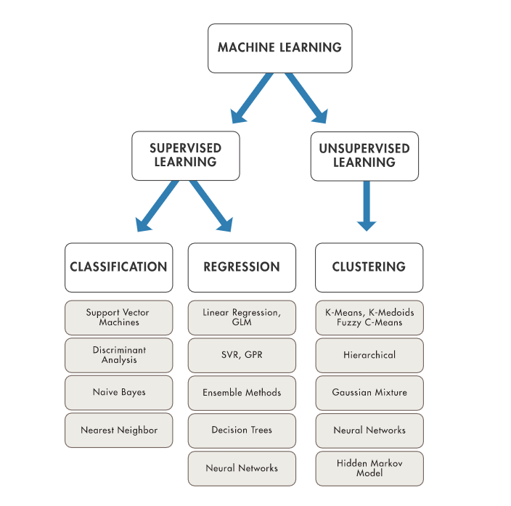
How do Models Work?
Decide Which Machine Learning Algorithm to Use?

Slide 7
Let’s Get Up and Running
Gaddis uses Python and IDLE (simple debugger) – https://www.python.org/
Online Debuggers for simple code – http://www.onlinegdb.com/
“Hello World” program
We will use the Anaconda Python Installation (with Jupyter Notebooks and Spyder IDE)
Install at: https://www.anaconda.com/distribution/
See short tutorial: https://www.dataquest.io/blog/jupyter-notebook-tutorial/
See short video: https://www.linkedin.com/learning/introducing-jupyter/installing-jupyter?u=74653834
Jupyter Notebook Quick Tutorial
See short video: https://www.linkedin.com/learning/introducing-jupyter/jupyter-interface?u=74653834
Other IDEs are available e.g. Anaconda Spyder, PyCharm (Community Edition) and Visual Studio
https://www.coursera.org/lecture/python-programming-introduction/introduction-to-the-spyder-ide-ywcuv
https://www.jetbrains.com/pycharm/download/#section=windows
Notes:
Lest try to use Anaconda python and get familiar with Jupyter notebooks
Open Anaconda - Jupyter notebook, Spyder
Go through a basic notebook and commands

Slide 8
Download Work Files:
shorturl.at/qryNT

